Slide 1
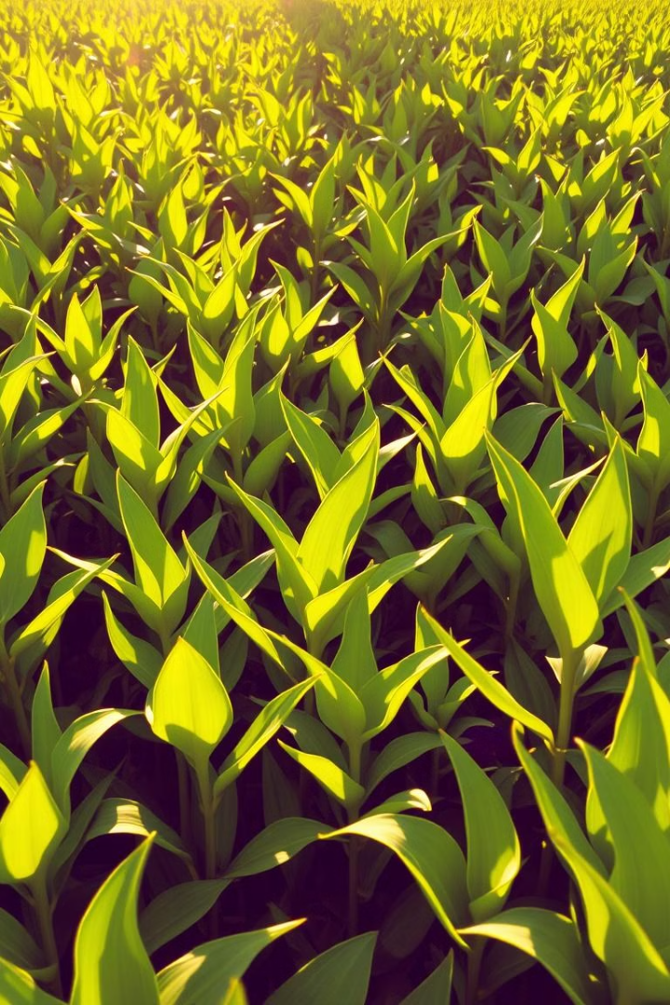
Fertilizer Prediction Project
This project leverages machine learning to predict the optimal fertilizer blend for crops, improving yield and sustainability.
JK
by Jashan Kaur

Slide 2

Introduction to the problem
1
Crop Yield Optimization
2
Sustainable Practices
Precision fertilization helps reduce fertilizer overuse, minimizing environmental impact.
Maximizing crop production is crucial for food security and economic prosperity.
3
Data-Driven Decisions
Leveraging data analytics allows farmers to make informed decisions about fertilizer applications.

Slide 3

Data Collection and Feature Engineering
1
Soil Sampling
Collected soil samples from various fields representing different soil types.
2
Crop Information
Gathered data on crop types, including their nutrient requirements and growth stages.
3
Environmental Data
Acquired environmental parameters like temperature, humidity, and moisture levels.
4
Feature Engineering
Derived new features, such as soil nutrient ratios and crop growth indices, to enhance model accuracy.

Slide 4
Exploratory Data Analysis (EDA)
Data Visualization
Correlation Analysis
Outlier Detection
Used histograms, scatter plots, and box plots to visualize data distributions and identify trends.
Investigated relationships between features, revealing strong correlations between soil nutrients and crop growth.
Identified and addressed outliers to ensure data quality and prevent model bias.

Slide 5

Handling Categorical Data with Label Encoding
Soil Type
Label
Sandy
0
Clay
1
Loamy
2
Categorical features like soil type and crop type were converted to numerical values using label encoding for model compatibility.

Slide 6
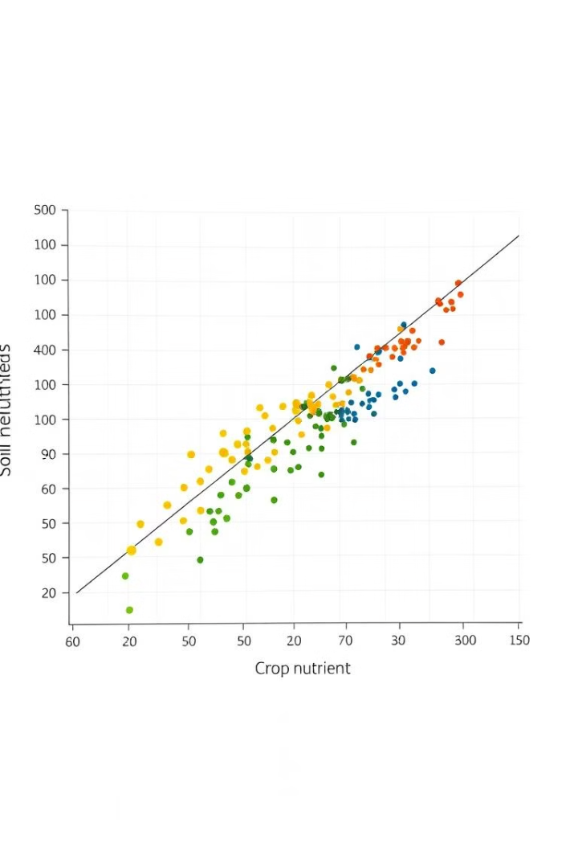



Understanding Feature Relationships
Nutrient Requirements
Different crops have varying nutrient requirements, impacting fertilizer recommendations.
Soil Composition
Soil type significantly influences nutrient availability, affecting fertilizer effectiveness.
Environmental Factors
Temperature, humidity, and moisture play crucial roles in nutrient uptake and crop growth.

Slide 7

Developing the Random Forest Classifier Model
Decision Trees
Ensemble Learning
Feature Importance
Random Forest combines multiple decision trees, each trained on a random subset of the data, reducing overfitting.
The model aggregates predictions from individual trees, resulting in improved accuracy and robustness.
Random Forest provides insights into the importance of each feature in making predictions.

Slide 8




Model Tuning with GridSearchCV
Hyperparameter Optimization
GridSearchCV systematically explores different combinations of hyperparameters to find the optimal model configuration.
Cross-Validation
Evaluates model performance on different subsets of the data, providing a more robust estimate of generalization accuracy.
Performance Evaluation
Uses metrics like accuracy, precision, and recall to assess the model's ability to accurately predict fertilizer requirements.

Slide 9
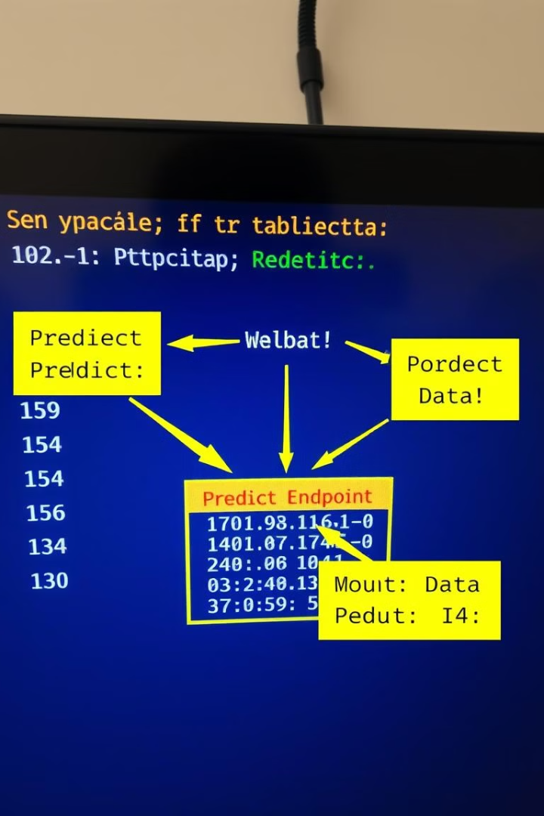
Deploying the Model as a Flask API
The trained and tuned model is saved using pickle, allowing for easy loading and deployment as a Flask API.

Slide 10
conclusion:
The Fertilizer Prediction Project uses a Random Forest Classifier to recommend optimal fertilizers based on soil, crop, and environmental conditions. The dataset includes features like temperature, humidity, moisture, nitrogen, potassium, and phosphorus. Categorical data (soil and crop types) were label-encoded, and EDA was performed to understand feature relationships. The trained model, tuned with GridSearchCV, was serialized using pickle for deployment.

Slide 11
Thank You

